Slide 1
Times tables
BIG 46

Slide 2
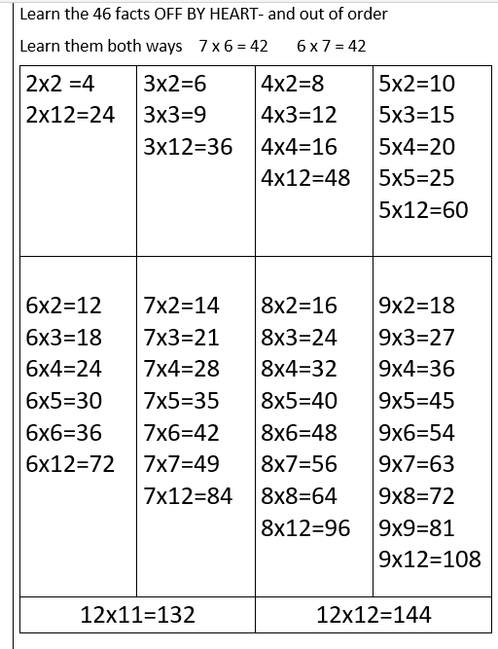

Slide 3
Times tables
BIG 46

Slide 4
2 x 12 =

Slide 5
2 x 2 =

Slide 6
3 x 2 =

Slide 7
3 x 3 =

Slide 8
3 x 12 =

Slide 9
4 x 12 =

Slide 10
4 x 4 =

Slide 11
4 x 3 =

Slide 12
4 x 2 =

Slide 13
5 x 2 =

Slide 14
5 x 3 =

Slide 15
5 x 4 =

Slide 16
5 x 5 =

Slide 17
5 x 12 =

Slide 18
6 x 2 =

Slide 19
6 x 3 =

Slide 20
6 x 4 =

Slide 21
6 x 5 =

Slide 22
6 x 6 =

Slide 23
6 x 12 =

Slide 24
7 x 2 =

Slide 25
7 x 3 =

Slide 26
7 x 4 =

Slide 27
7 x 5 =

Slide 28
7 x 6 =

Slide 29
7 x 7 =

Slide 30
7 x 12 =

Slide 31
8 x 2 =

Slide 32
8 x 3 =

Slide 33
8 x 4 =

Slide 34
8 x 5 =

Slide 35
8 x 6 =

Slide 36
8 x 7 =

Slide 37
8 x 8 =

Slide 38
8 x 12 =

Slide 39
8 x 2 =

Slide 40
9 x 3 =

Slide 41
9 x 4 =

Slide 42
9 x 5 =

Slide 43
9 x 6 =

Slide 44
9 x 7 =

Slide 45
9 x 8 =

Slide 46
9 x 9 =

Slide 47
9 x 12 =

Slide 48
11 x 12 =

Slide 49
12 x 12 =

