Slide 1

Jingle Bells

Slide 2
C C C C
Jingle bells, jingle bells, jingle all the way
F C D7 G
Oh, what fun it is to ride on a one-horse open sleigh, hey
C C C C
Jingle bells, jingle bells, jingle all the way
F C G C
Oh, what fun it is to ride on a one-horse open sleigh

Slide 3
C C C F
Dashing through the snow on a one-horse open sleigh
F G G C
Over fields we go, laughing all the way
C C C F
Bells on bobtails ring, making spirits bright
F C G C
What fun it is to ride and sing a sleighing song tonight, oh

Slide 4
C C C C
Jingle bells, jingle bells, jingle all the way
F C D7 G
Oh, what fun it is to ride on a one-horse open sleigh, hey
C C C C
Jingle bells, jingle bells, jingle all the way
F C G C
Oh, what fun it is to ride on a one-horse open sleigh
(Repeat)

Slide 5
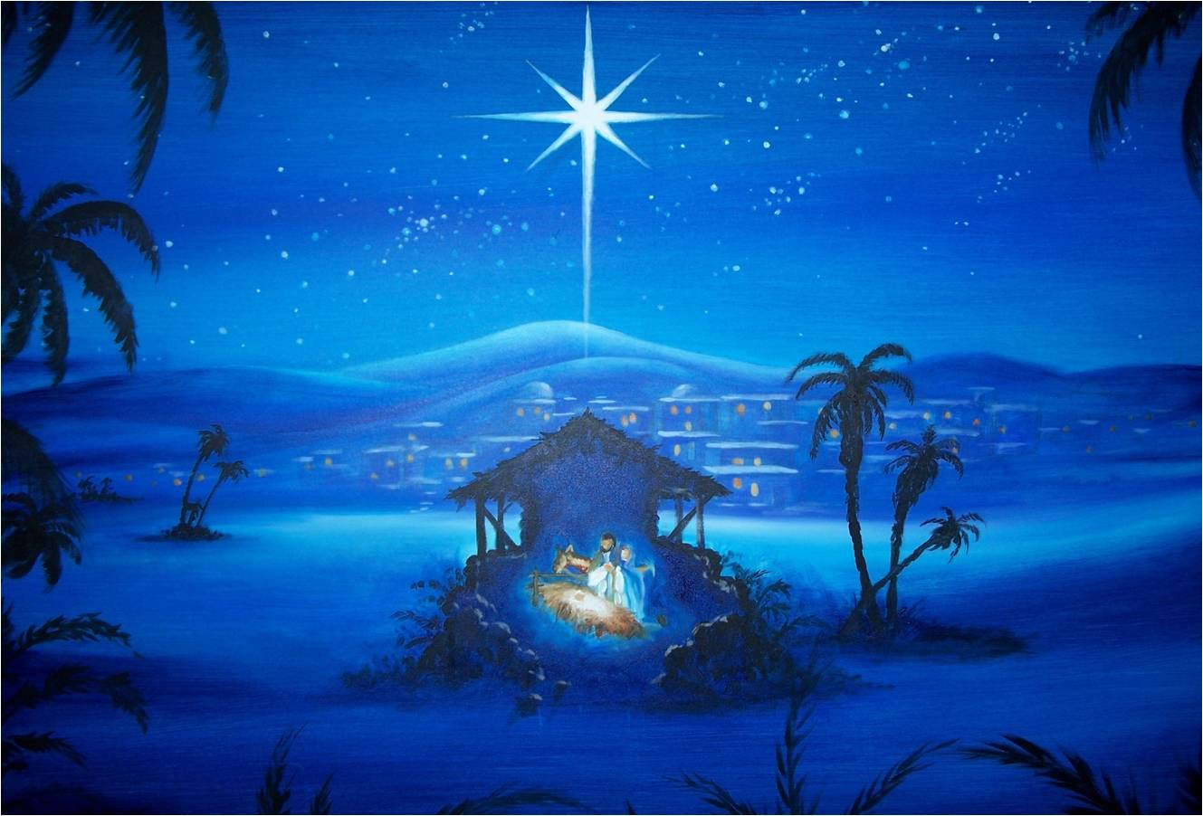
Silent Night

Slide 6
C C
Silent night, holy night
G C
All is calm, all is bright
F C
Round yon virgin, mother and child
F C
Holy infant so tender and mild
G C
Sleep in heavenly peace
C G C
Sleep in heavenly peace

Slide 7
C C
Silent night, holy night
G C
Shepherds quake at the sight
F C
Glories stream from heaven afar
F C
Heavenly hosts sing Alleluia
G C
Christ the Saviour is born
C G C
Christ the Saviour is born

Slide 8

We Wish You A Merry Christmas

Slide 9
C F
We wish you a merry Christmas
D7 G
We wish you a merry Christmas
E7 Am
We wish you a merry Christmas
F G C
And a happy new year

Slide 10
C G
Glad tidings we bring
D7 G
To you and your kin
C G
Good tidings for Christmas
F G C
And a happy new year

Slide 11
C F
We wish you a merry Christmas
D7 G
We wish you a merry Christmas
E7 Am
We wish you a merry Christmas
F G C
And a happy new year (Repeat)

